Slide 1
Packers and Movers

Slide 2
This project present in git repository in below URL
https://github.com/Kaleakash/moversandpackers.git
Plz login to virtual lab and clone this project in virtual lab using command as
git clone https://github.com/Kaleakash/moversandpackers.git

Slide 3
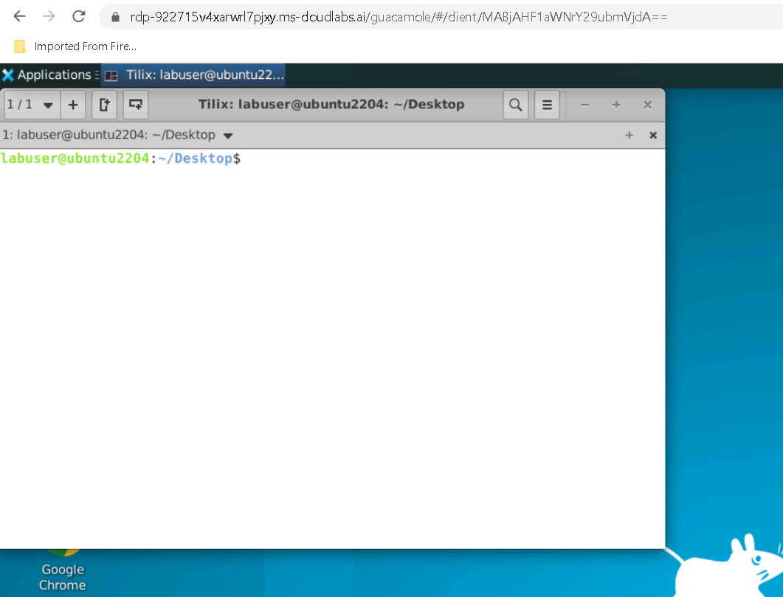

Slide 4
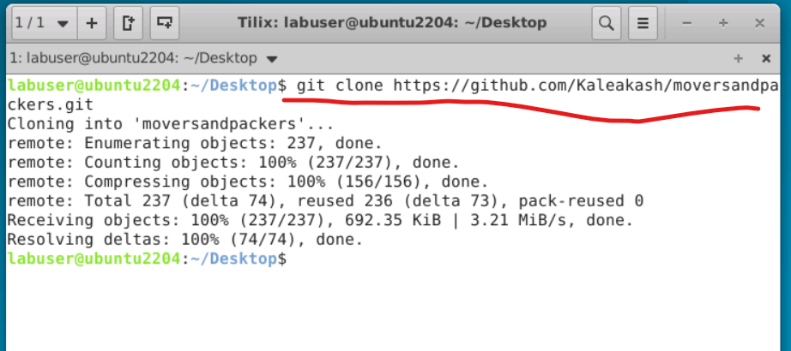
After clone project

Slide 5
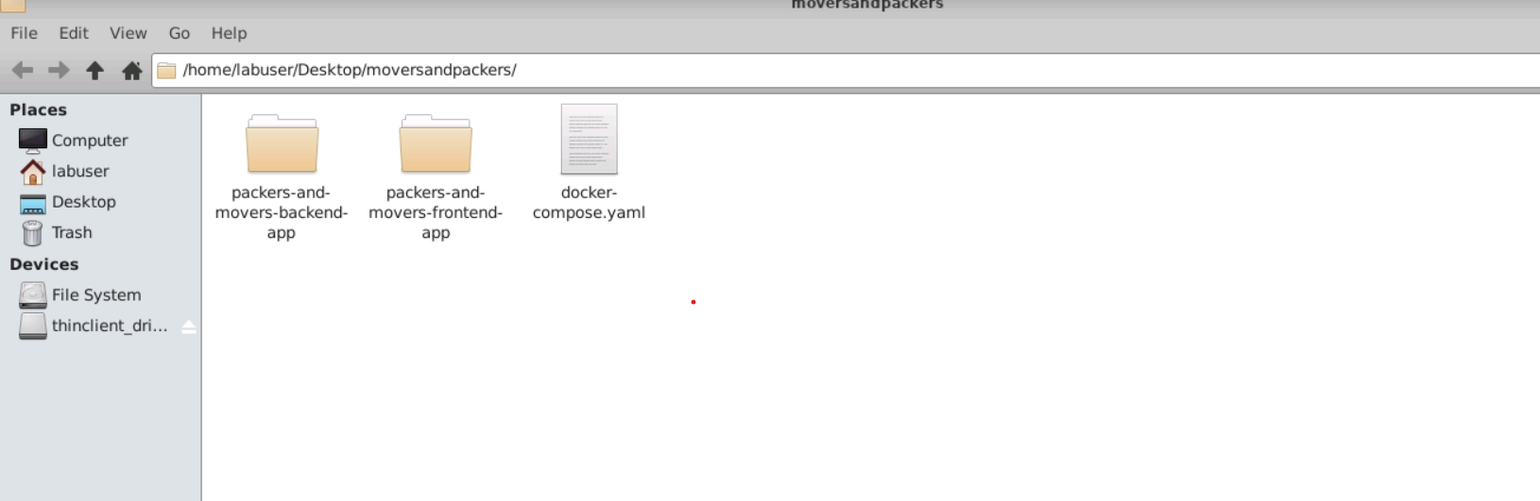
Project structure path

Slide 6
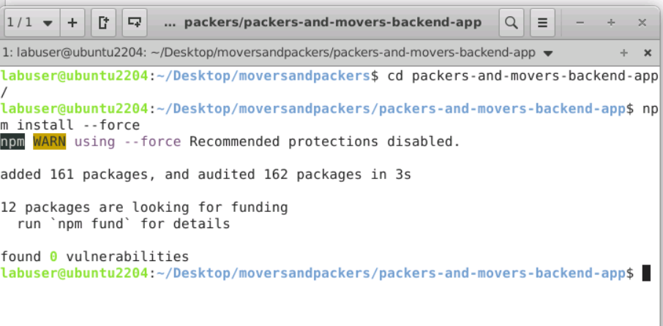
First move inside a packers-and-movers-backend-app
Then run the command as npm install to install all required dependencies.

Slide 7
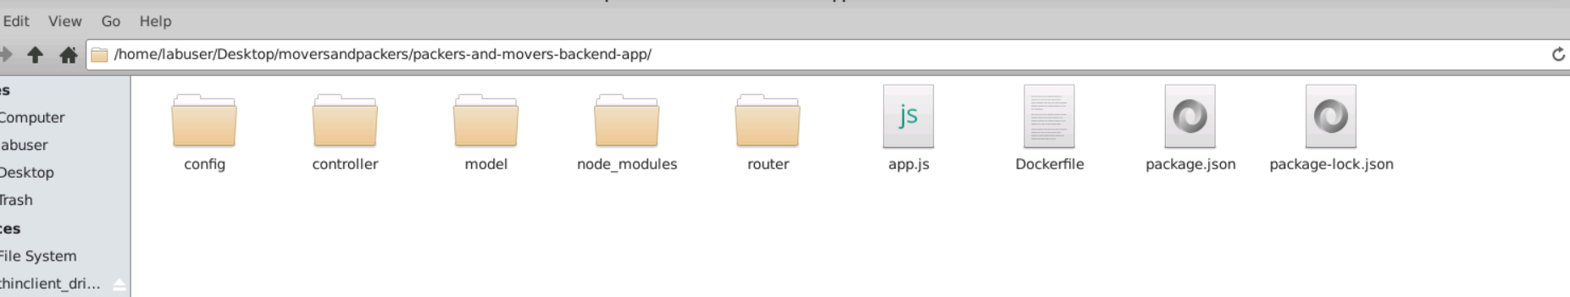
After updated you can see the structure of the project

Slide 8
Project structure explanation
Config : this folder contains database configuration details as well as initial set up for database. If we use local machine database then ip address must be local host or 127.0.0.1 with port number 27018.if we use Docker container then mongo db container name ie present in docker-compose.yml file as database.

Slide 9
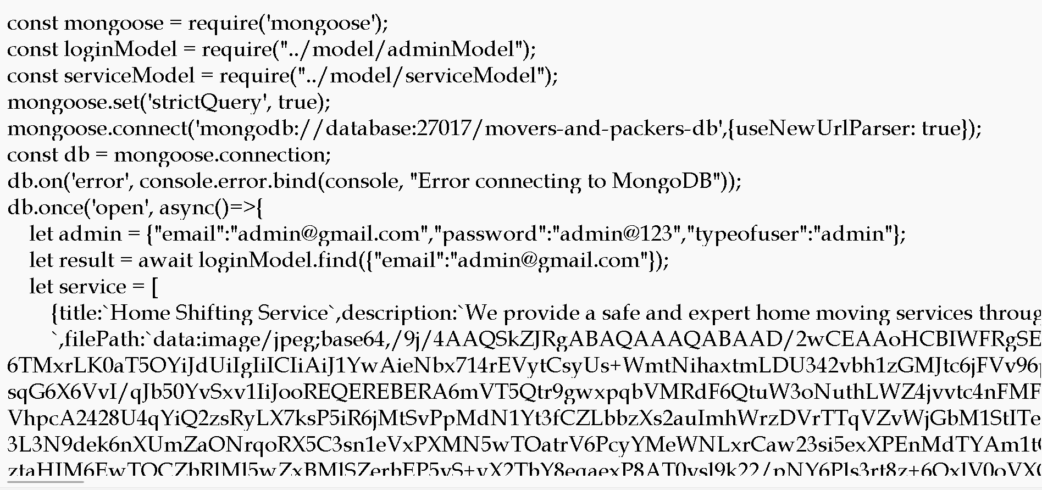

Slide 10
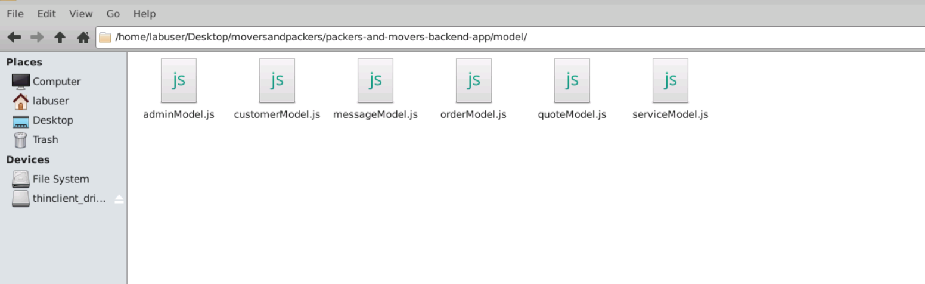
Model file: this file contains the structure of collection with schema definition

Slide 11
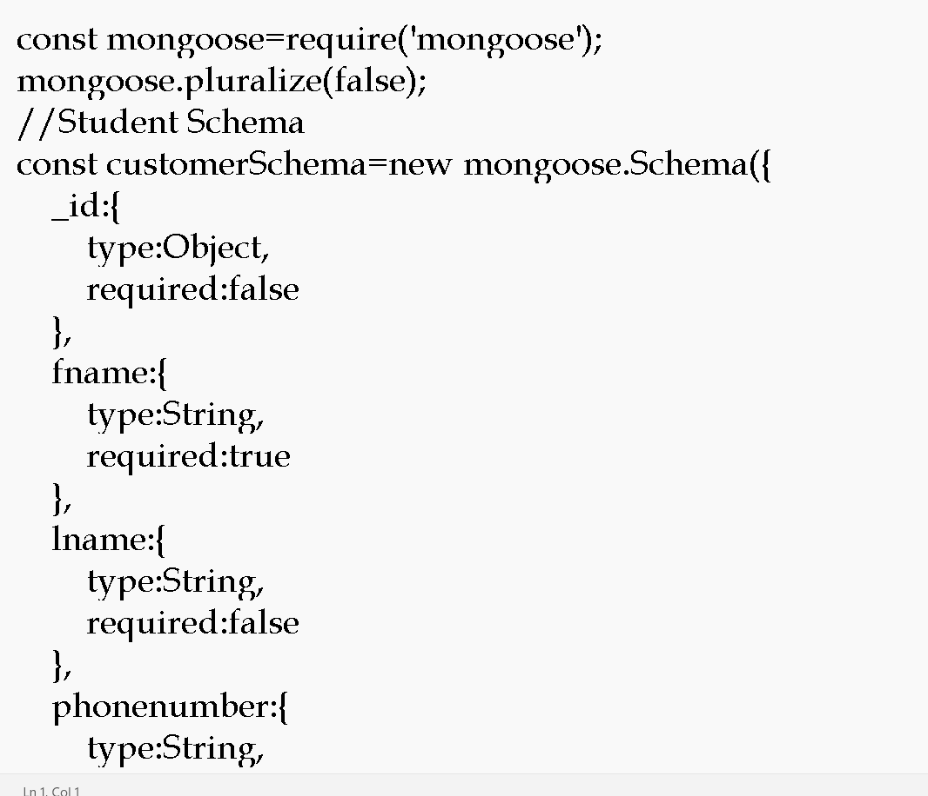

Slide 12
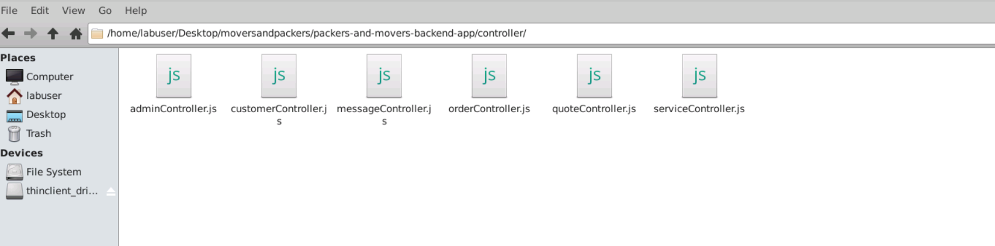
Controller file : which takes req and res and do the operation on model

Slide 13
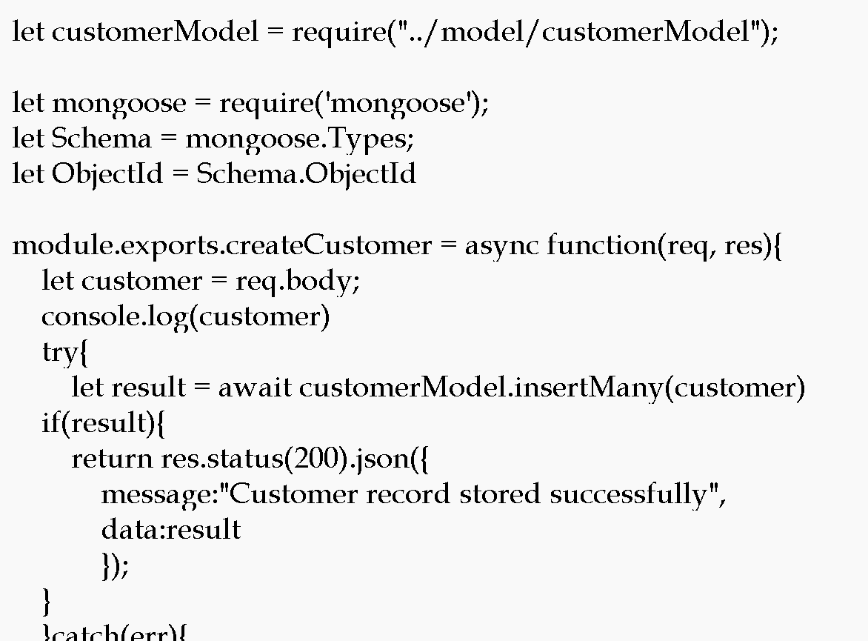

Slide 14
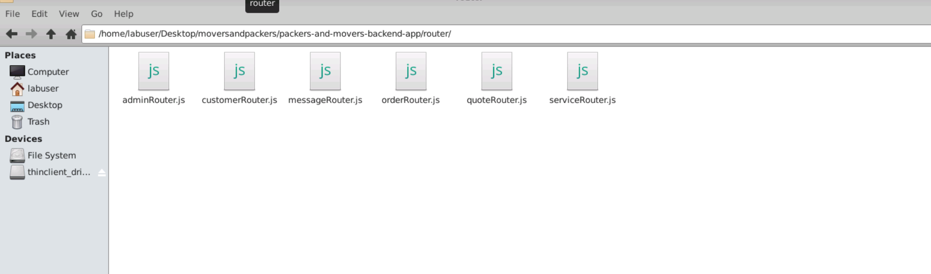
Router : it is use to map the request and http methods.

Slide 15
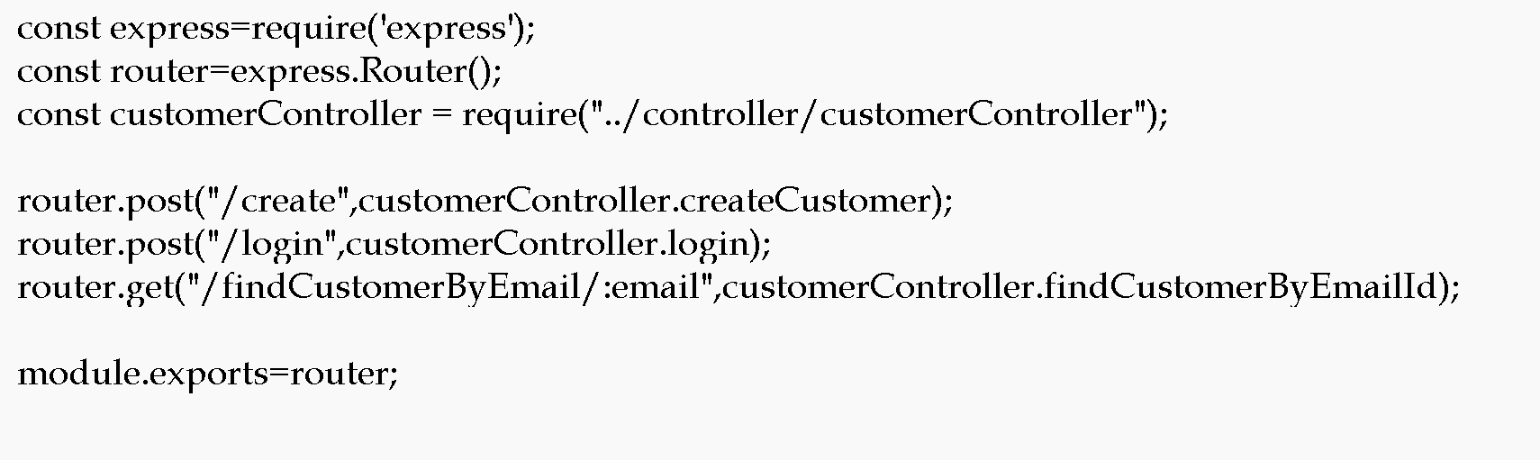

Slide 16
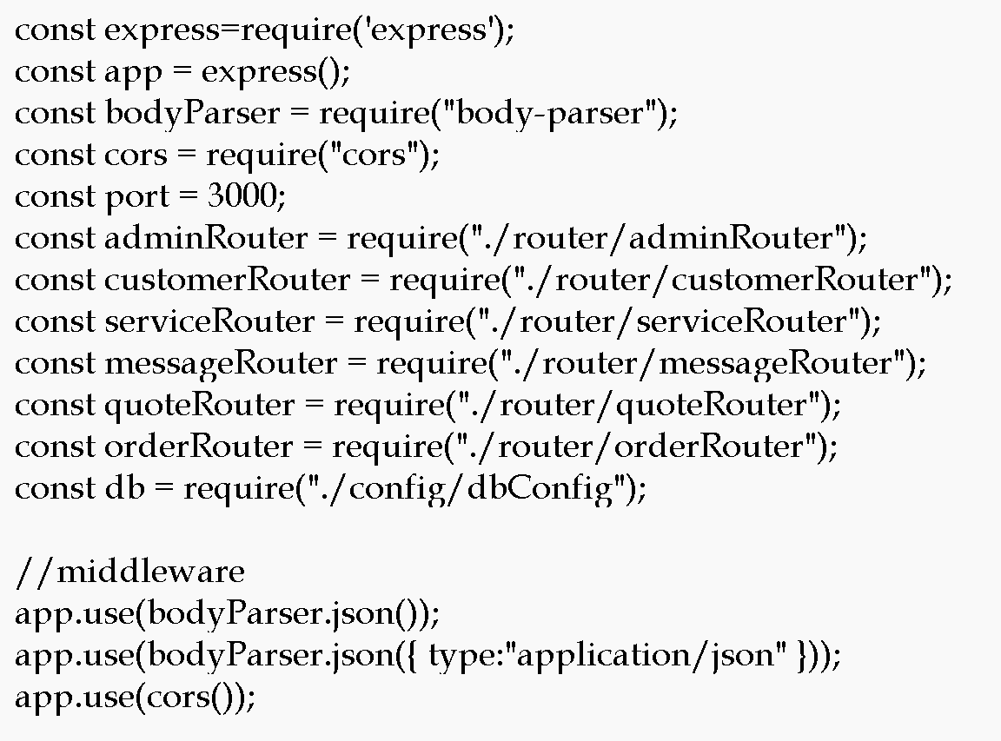
App.js : this is main file. Entry of the application

Slide 17
We will create Dockerfile
We are going to run the project using docker container so we need to create the Dockerfile.

Slide 18
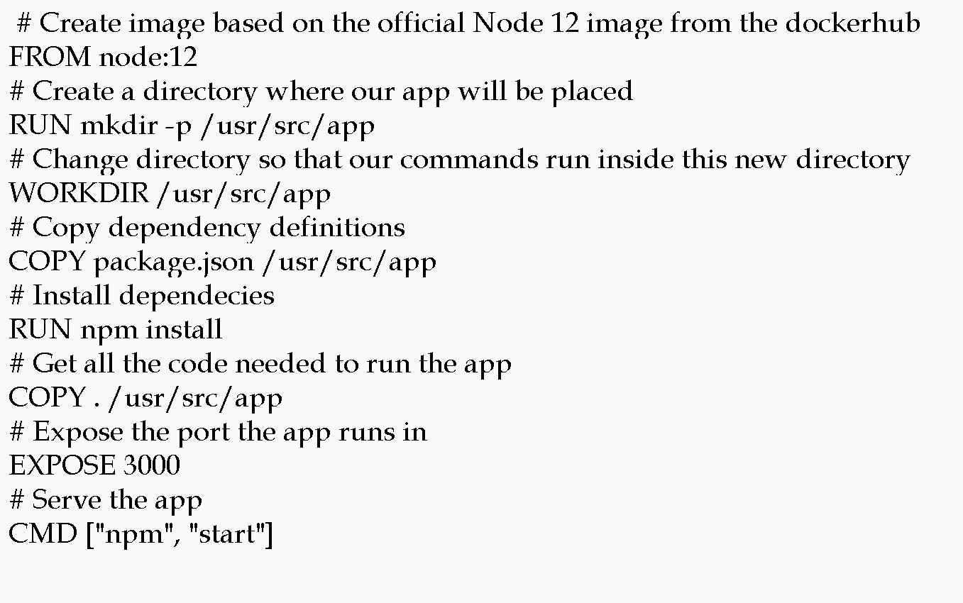

Slide 19
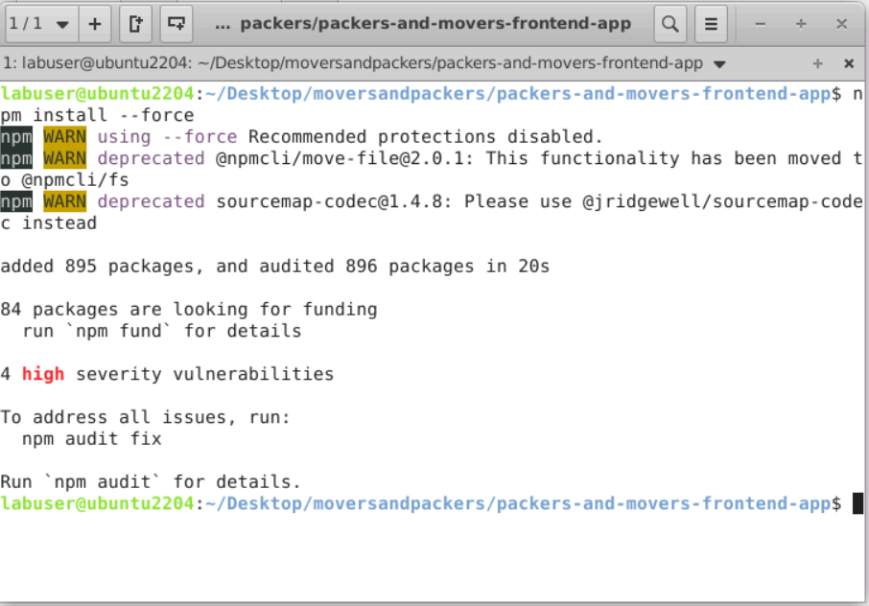
Now move inside a packers-and-movers-frontend-app
Then run the command as npm install --force to install all required dependencies.

Slide 20
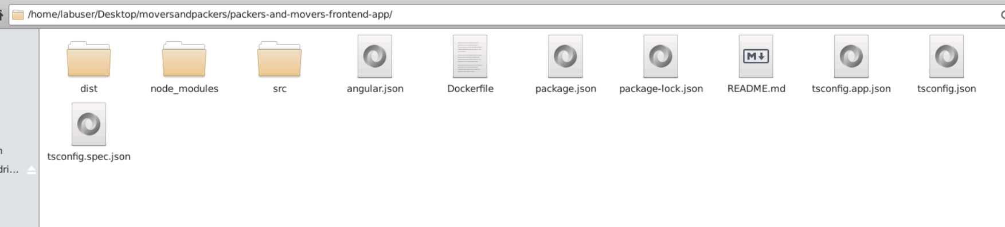
Front – angular project structure

Slide 21
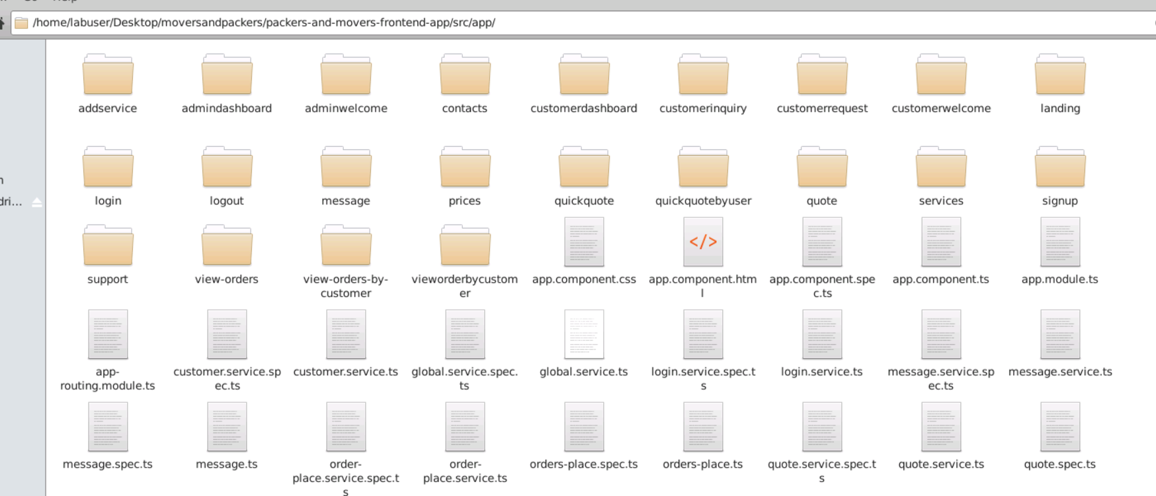
Project structure
Angular project contains lot of components, service as well as model classes .

Slide 22
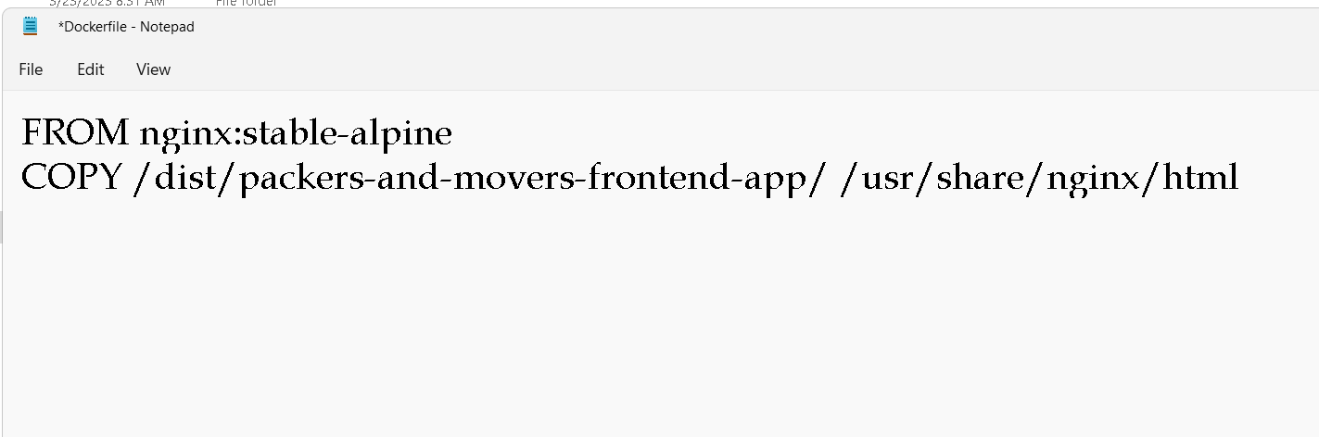
Now we will create the Dockerfile
We are going to run angular project using Dockerfile

Slide 23
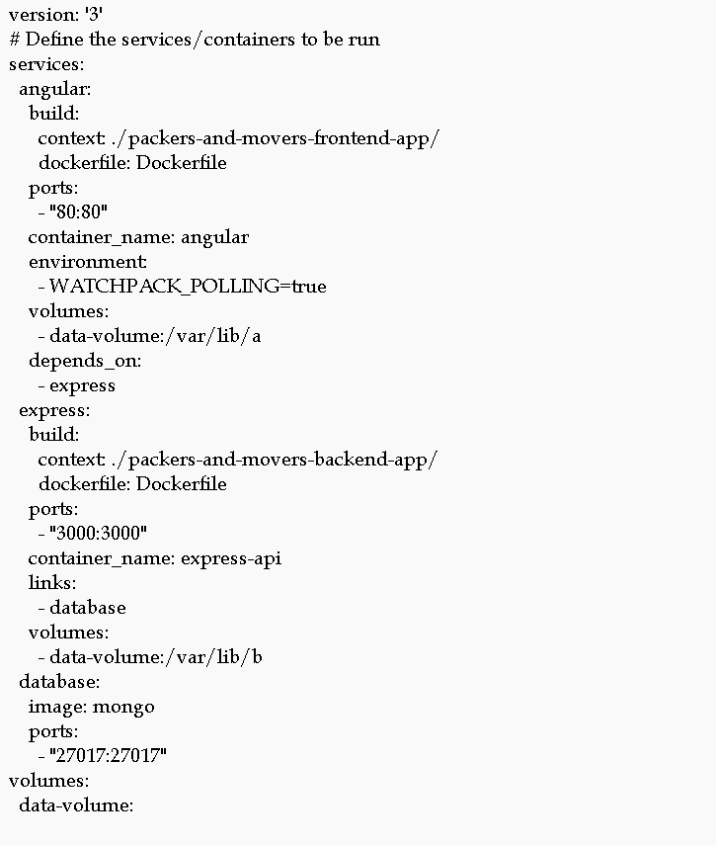
Now will create the docker-compose.yml

Slide 24
Now run the docker-compose file
sudo docker-compose up –build -d

Slide 25
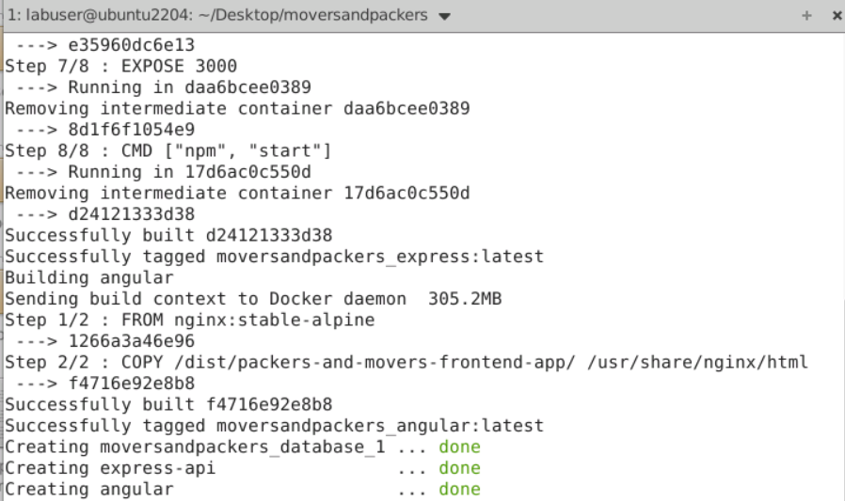

Slide 26
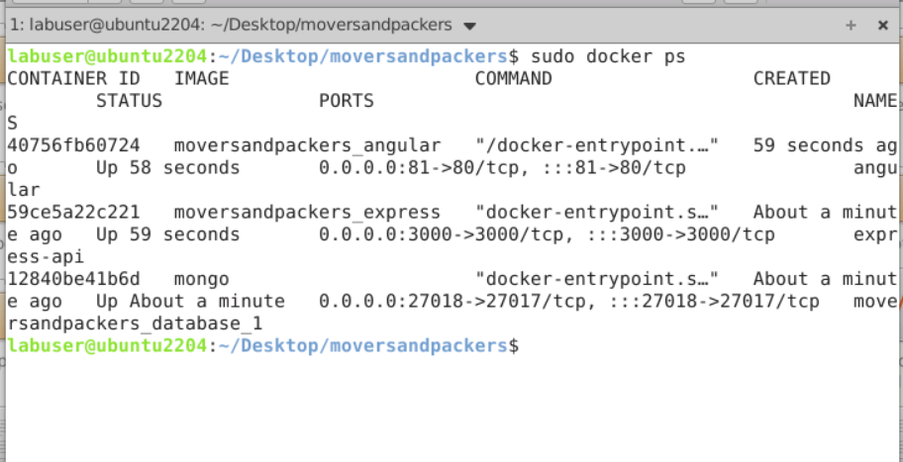
If everything go fine
Then three container get start.
sudo docker ps

Slide 27
Container details
Angular running with nginx server with 81 port number.
Express js running on port number 3000 port number
Mongo db database running on 27018 port number.

Slide 28
Now run the application using url as
http://localhost:81

Slide 29
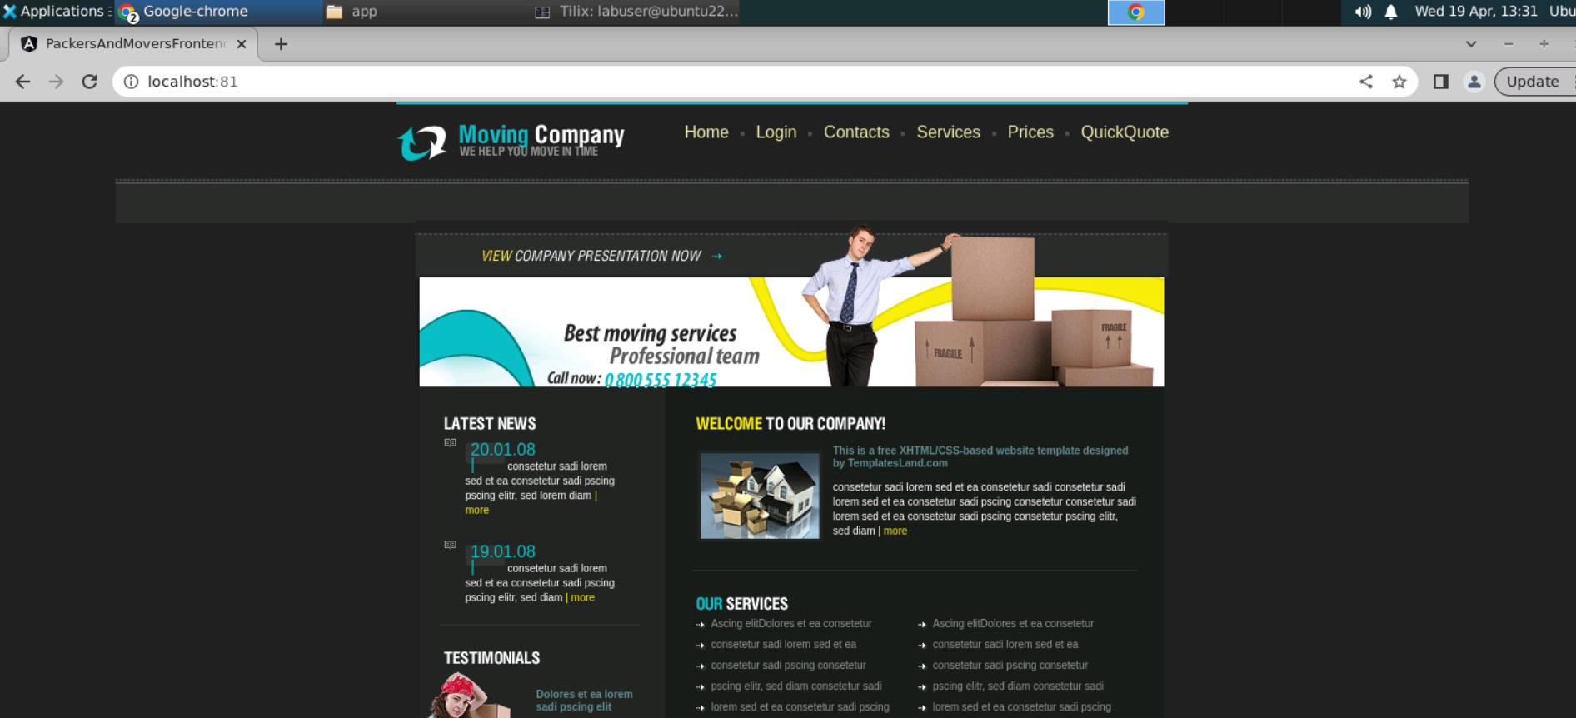

Slide 30
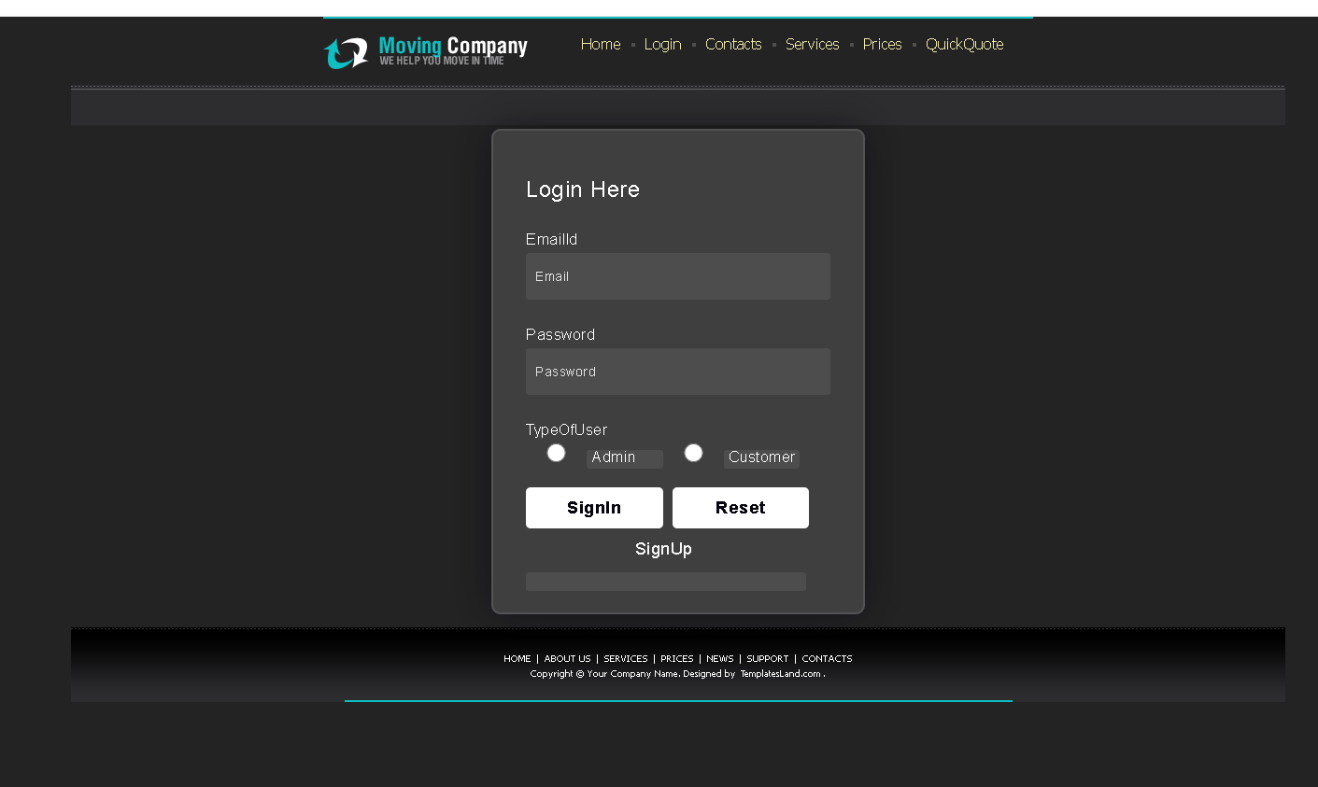
Login

Slide 31
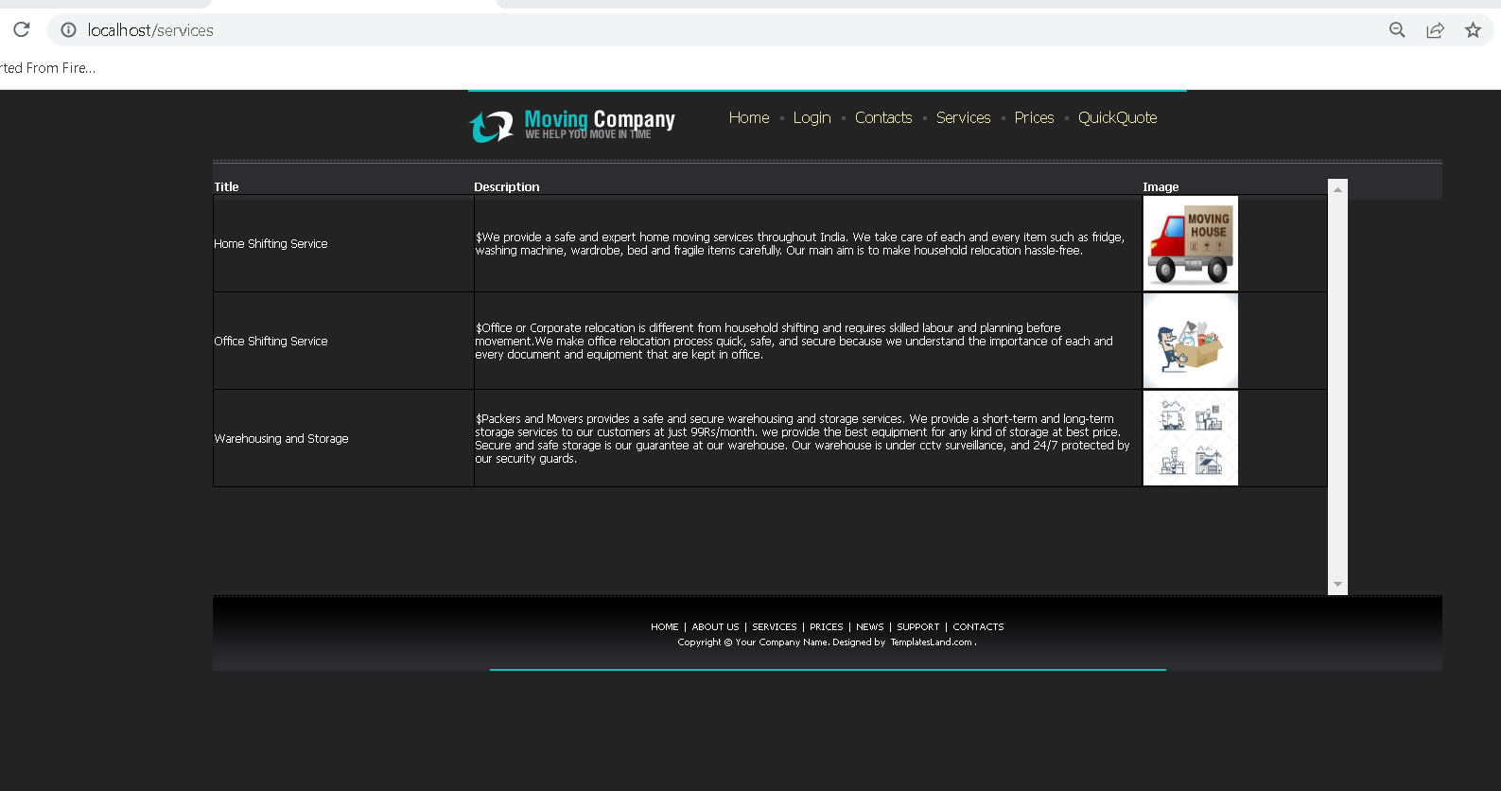
Services

Slide 32
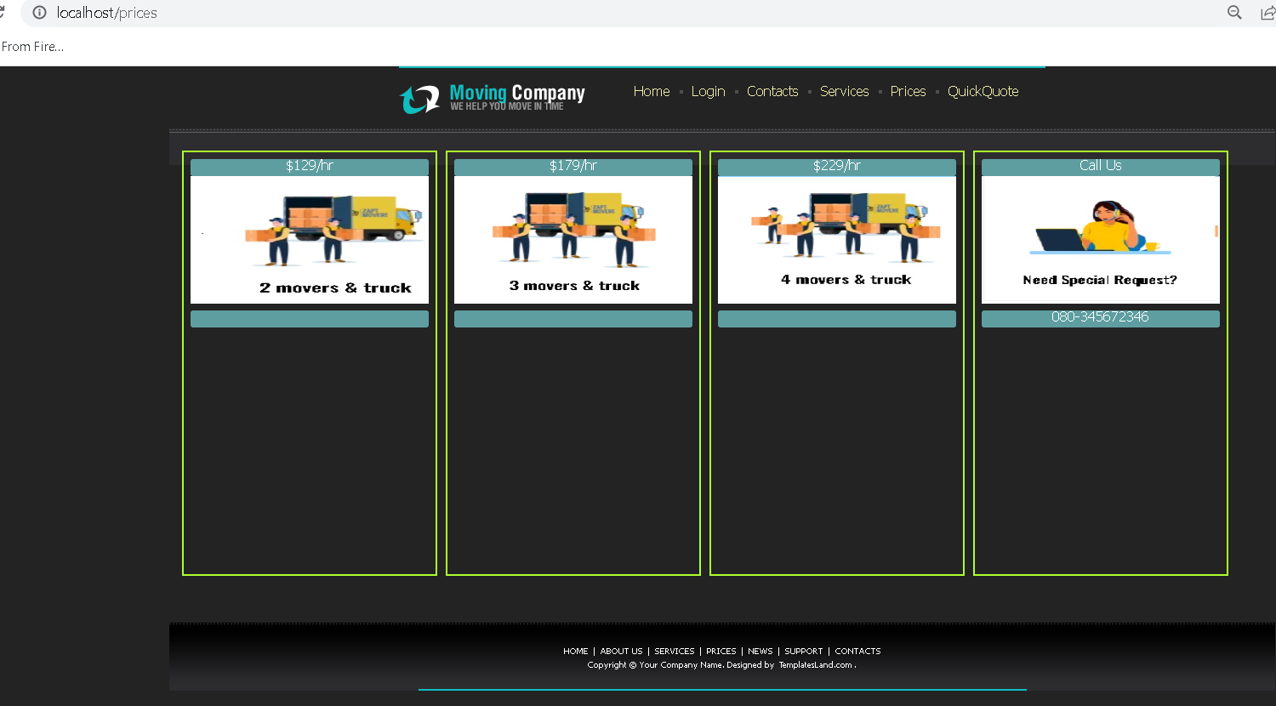
Prices

Slide 33
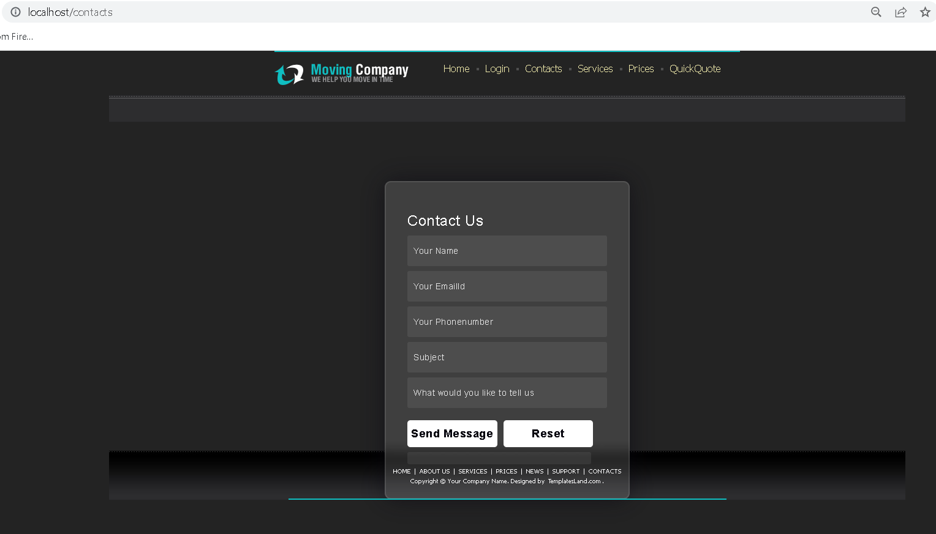
Guest user can send the message

Slide 34
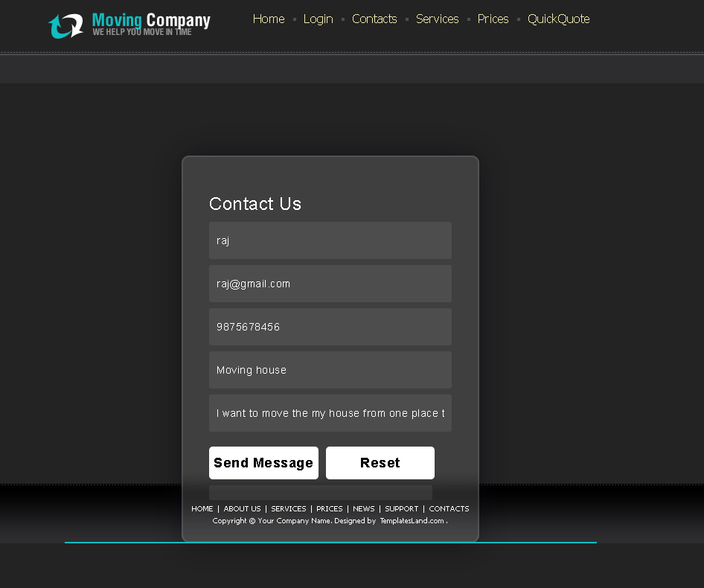
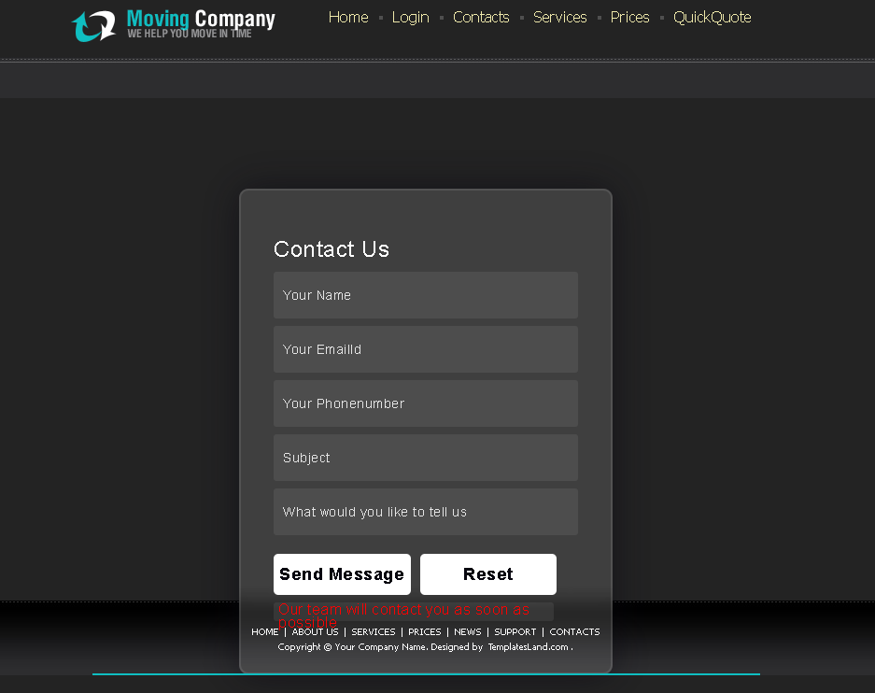
Contact us

Slide 35
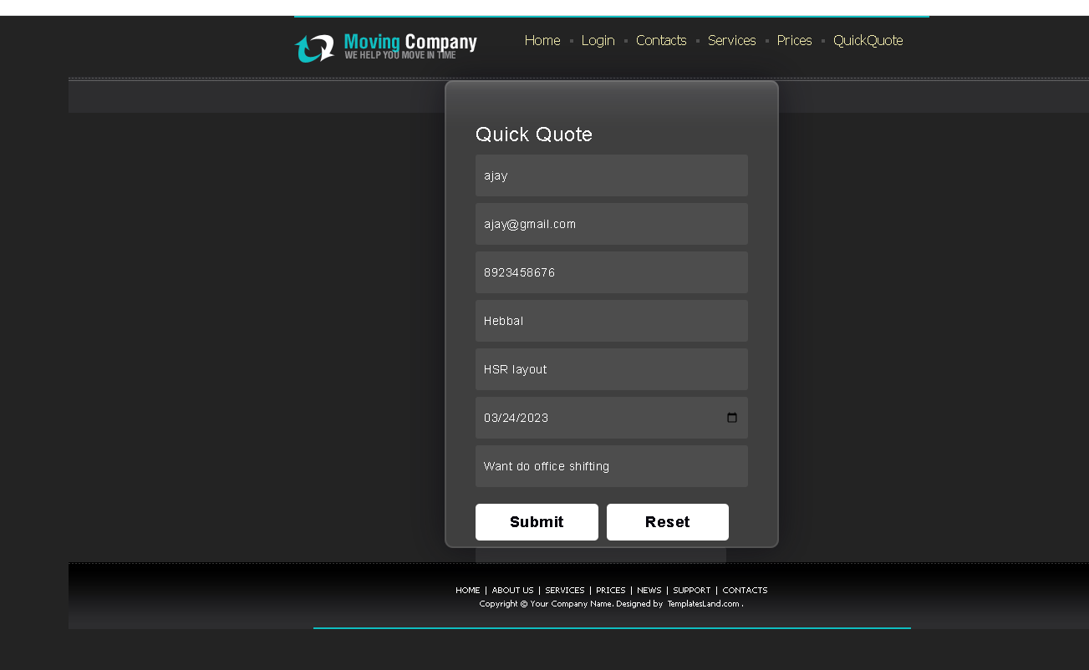
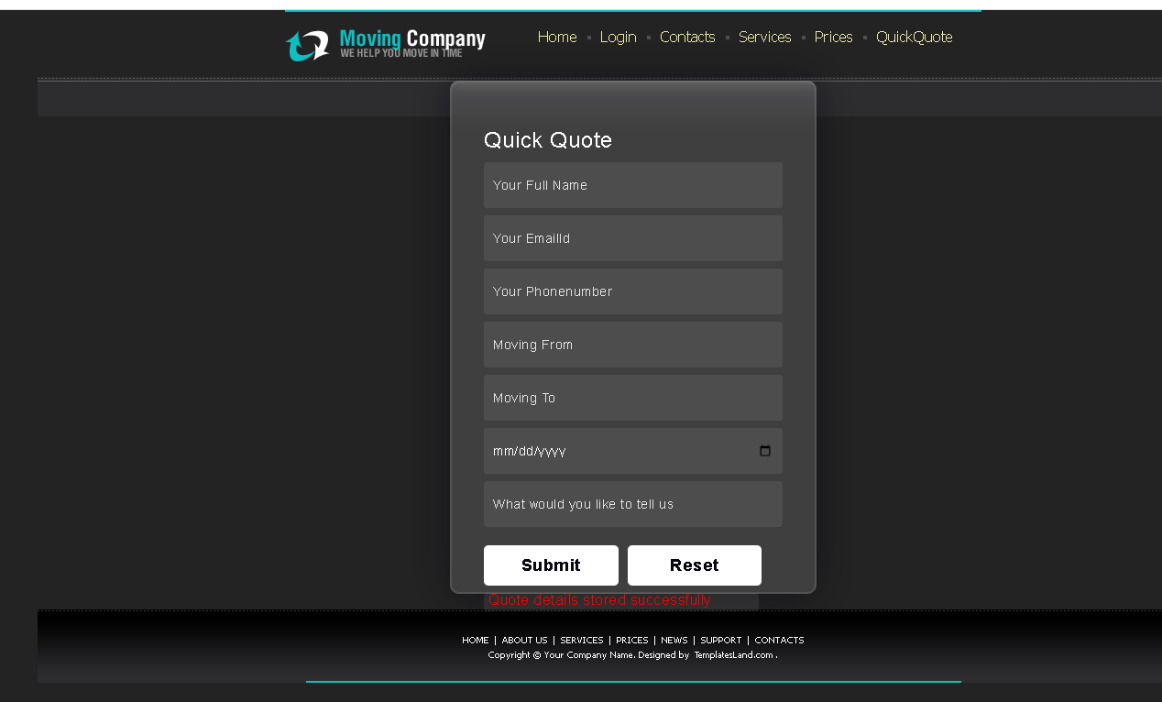
Quick quote by guest user

Slide 36
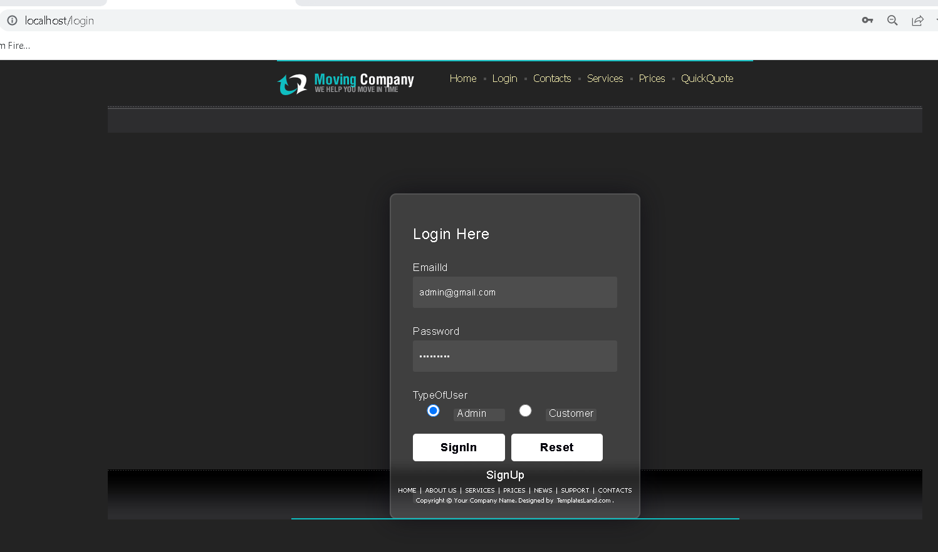
Admin login with emailid as admin@gmail.com and password as admin@123

Slide 37
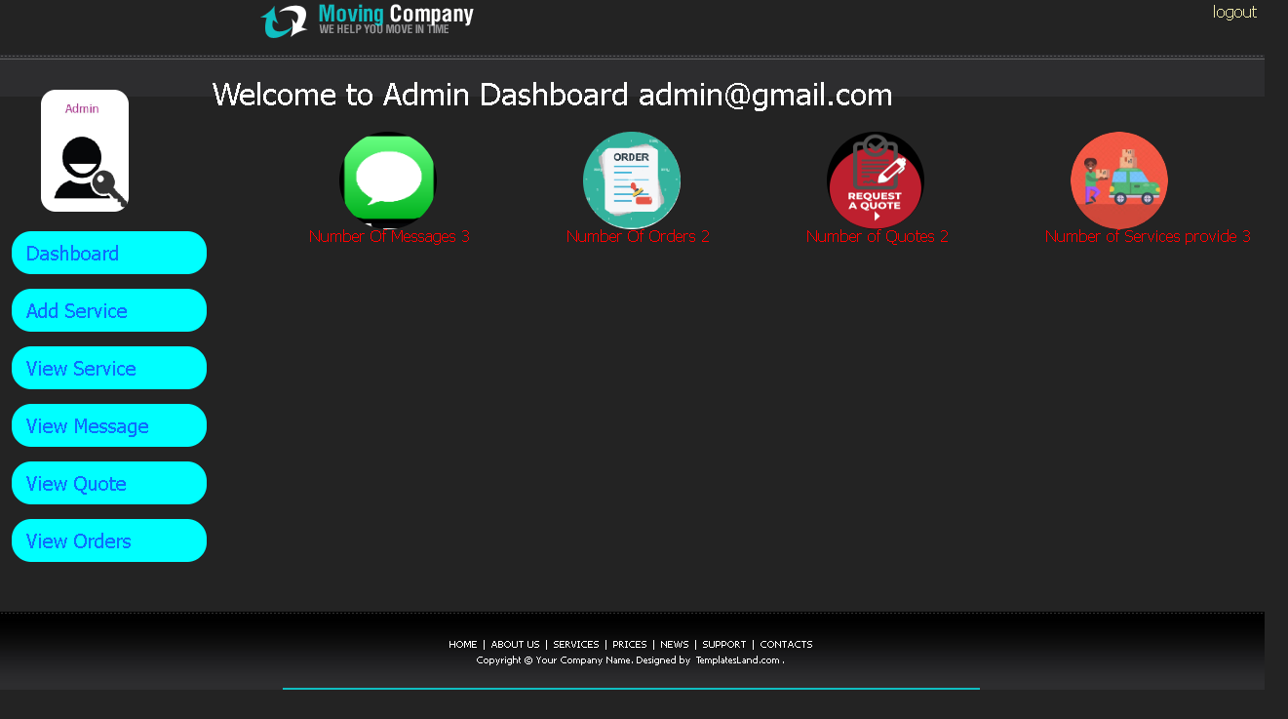
Admin home page

Slide 38
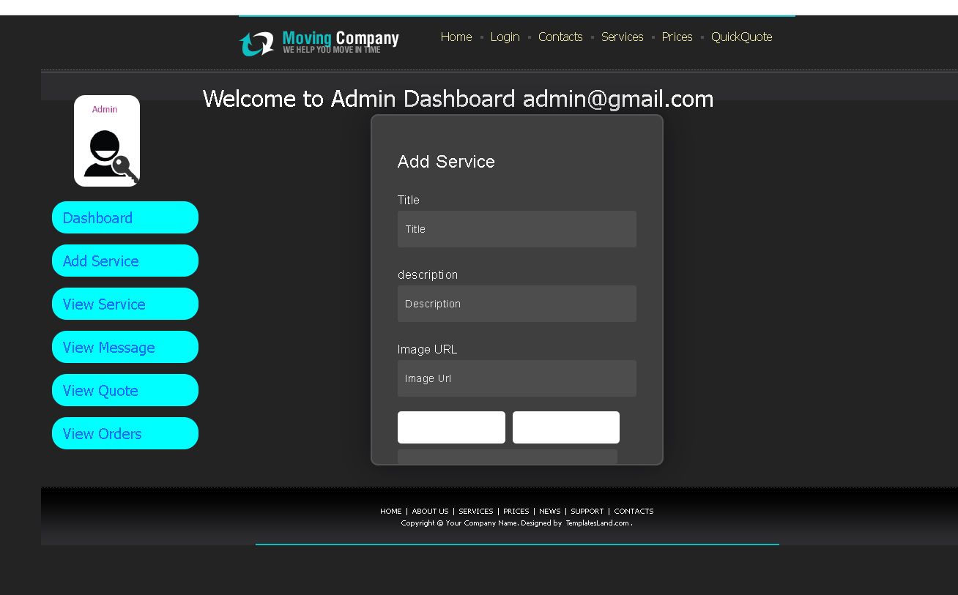
Admin can add the new service

Slide 39
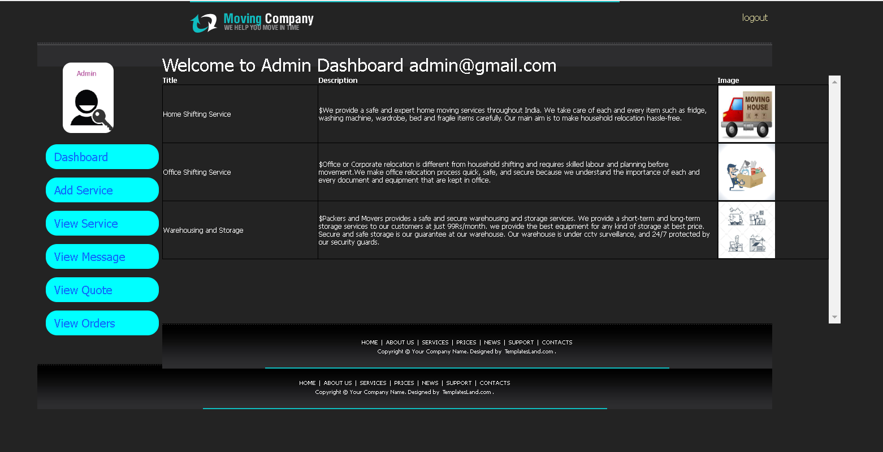
Admin can view existing services

Slide 40
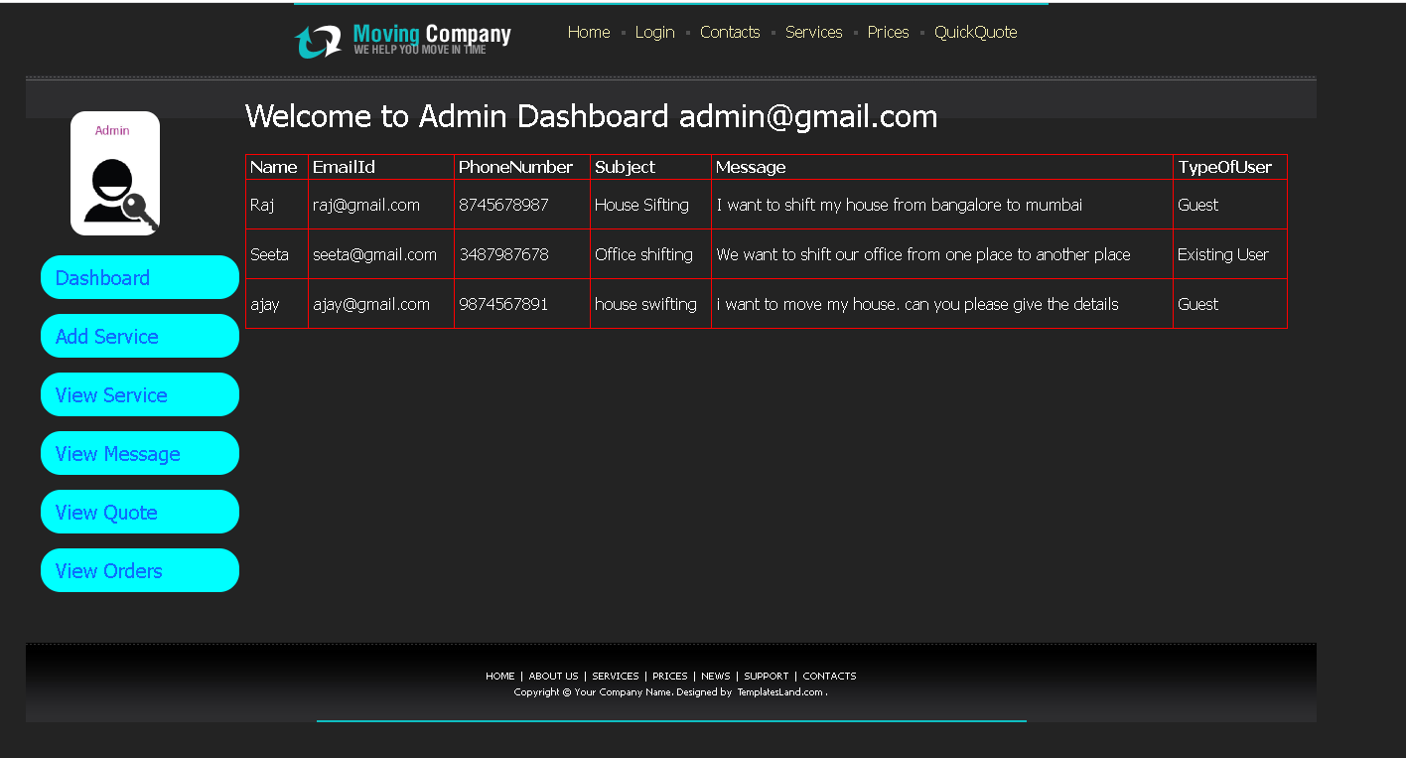
Admin can view the messages sent by guest user or existing user

Slide 41
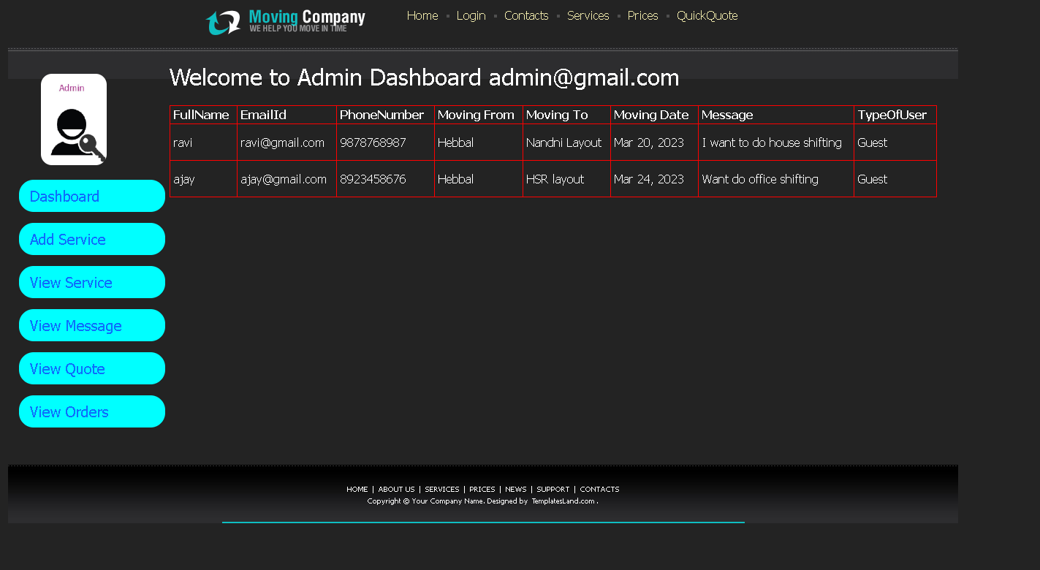
Admin can view the quote details send by guest user or existing user

Slide 42
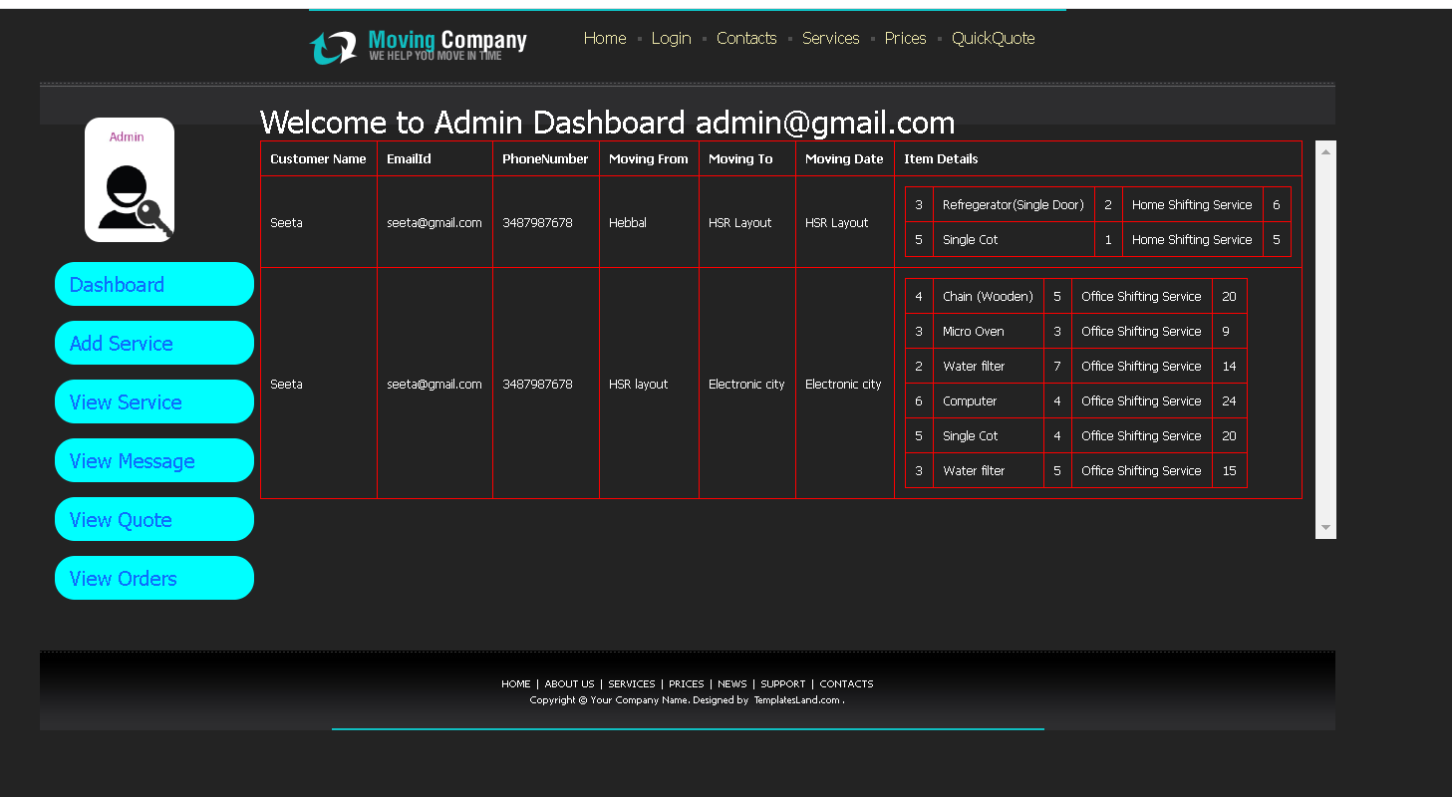
Admin can view order details sent

Slide 43
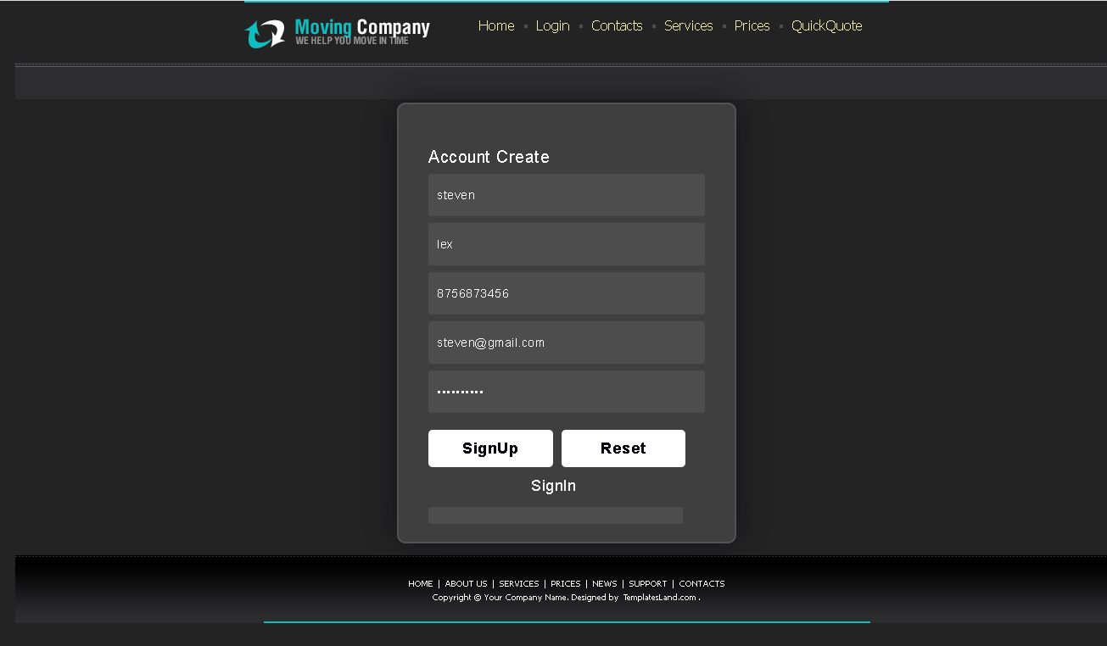
Now we will create customer account

Slide 44
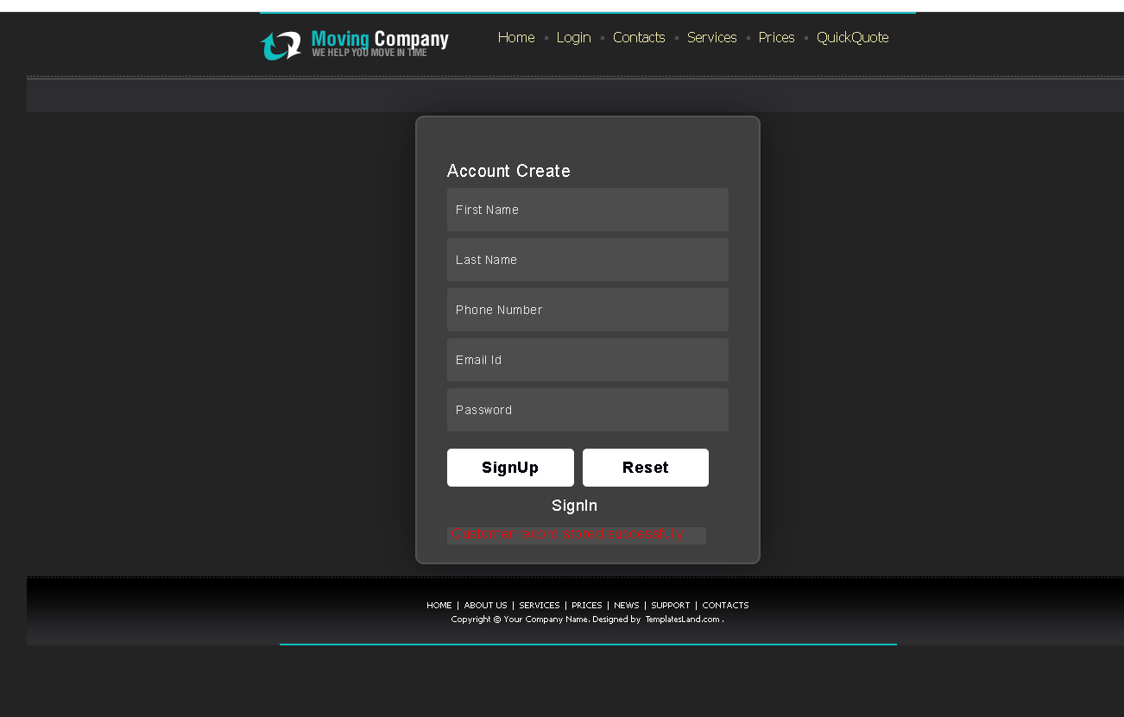
After customer account created

Slide 45
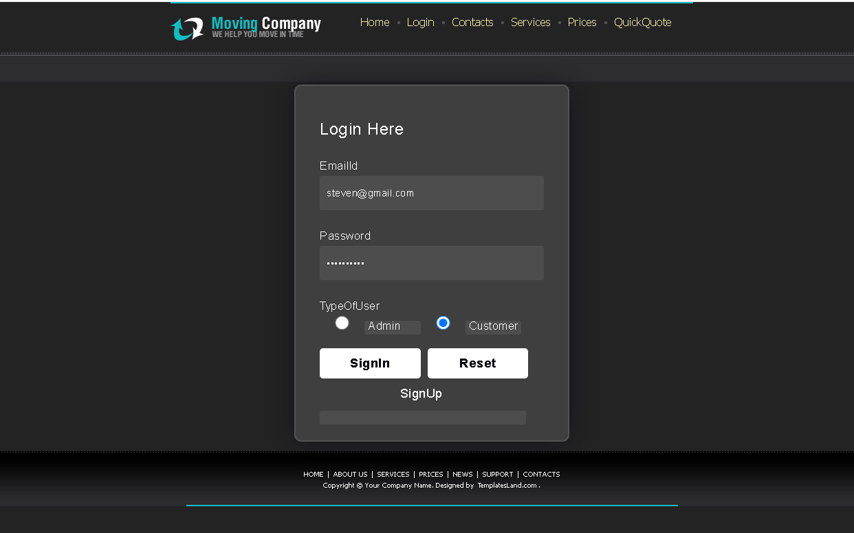
Customer login

Slide 46
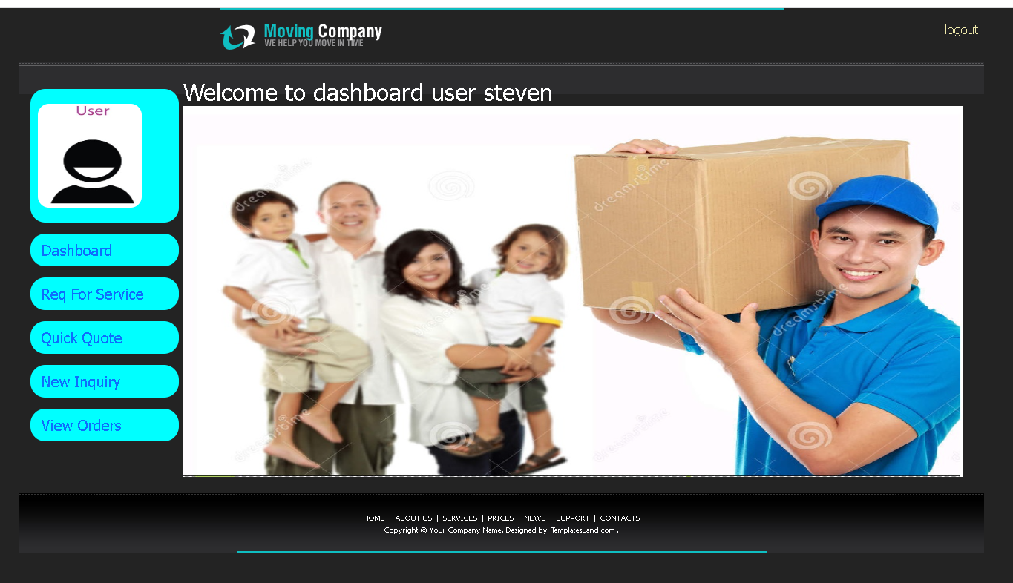
Customer home page

Slide 47
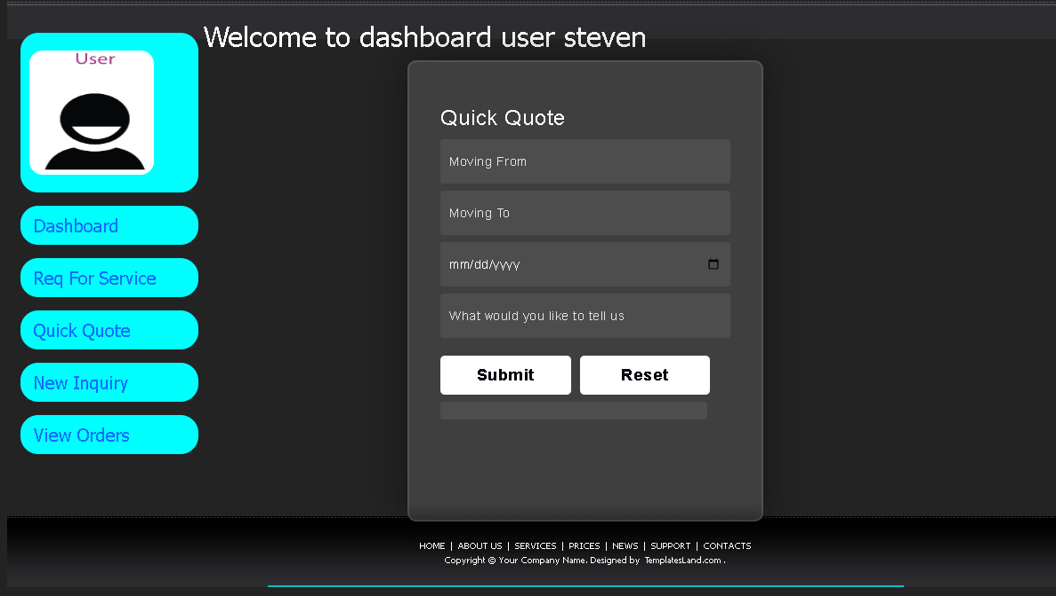
Quick quote by customer

Slide 48
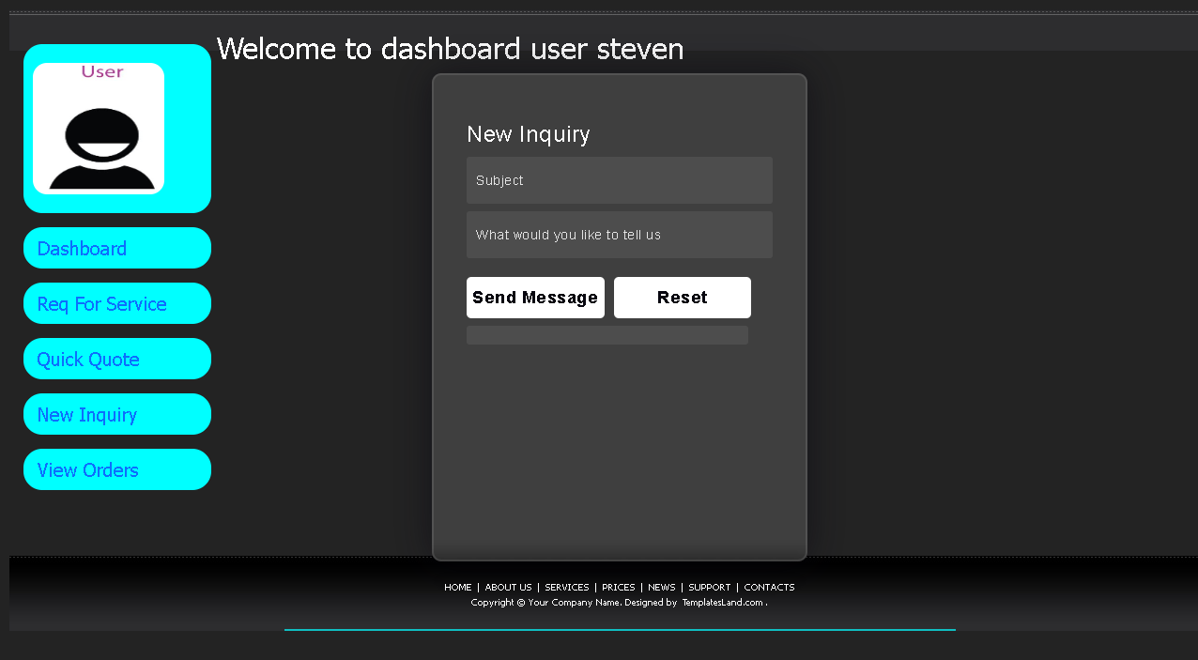
Quick inquiry by customer

Slide 49
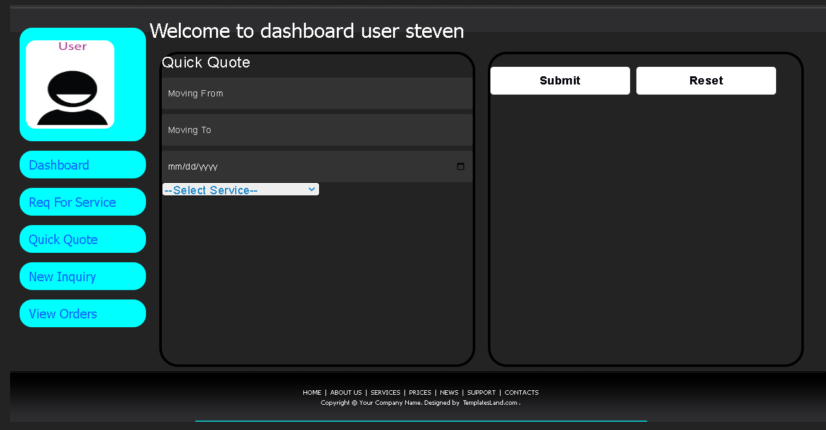
Request by customer

Slide 50
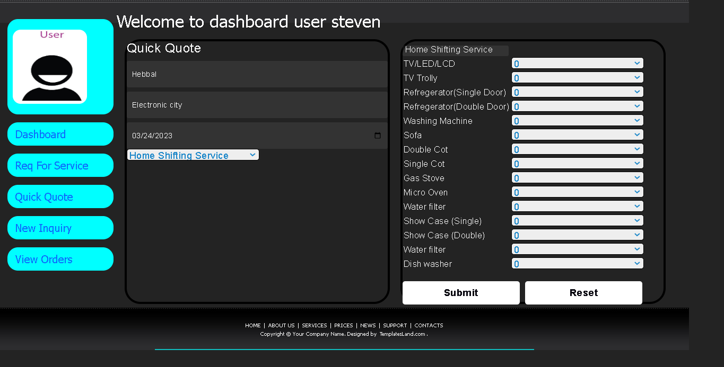
After selected specific service by customer

Slide 51
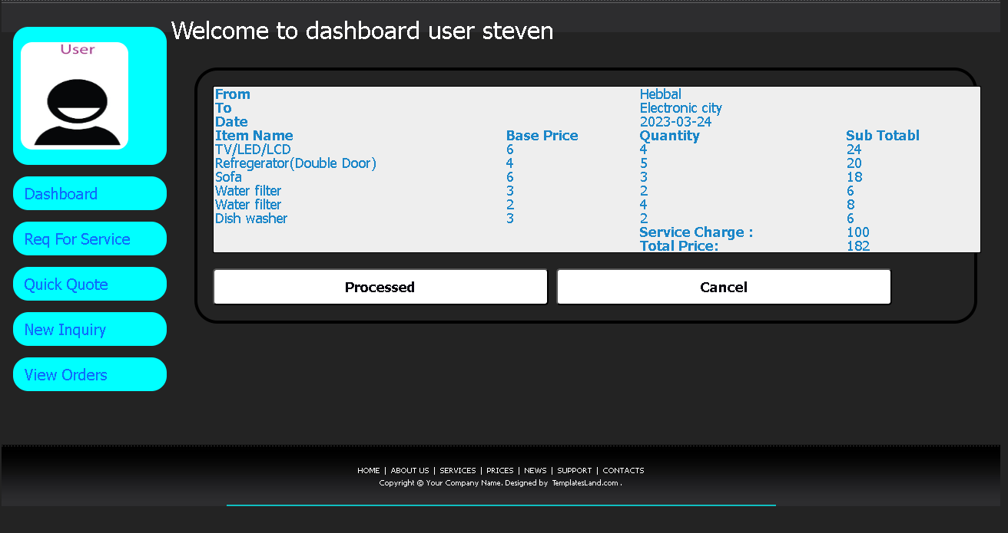
After filled all details

Slide 52
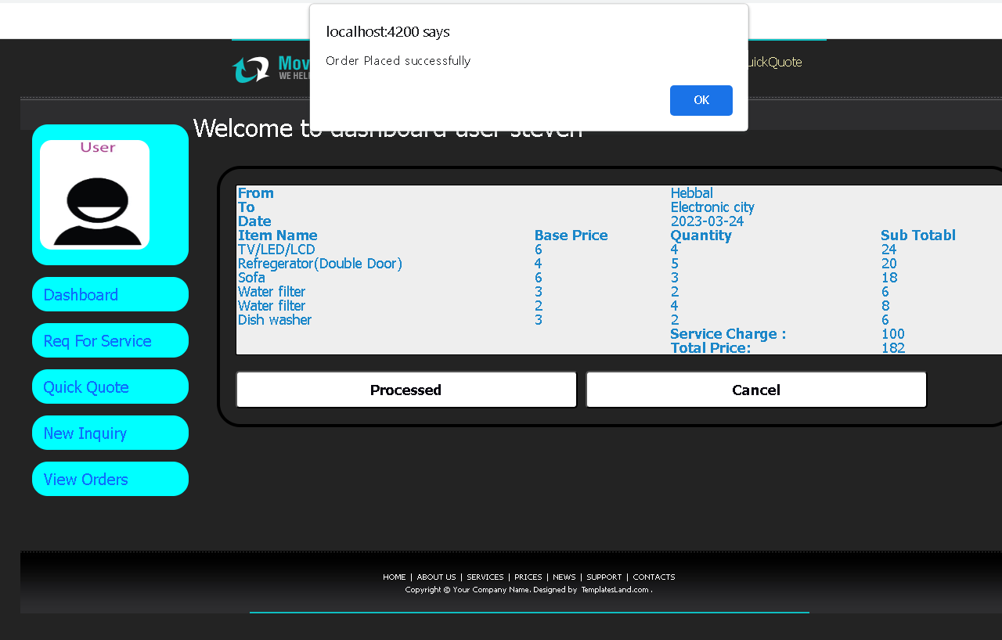
Then processed the request

Slide 53
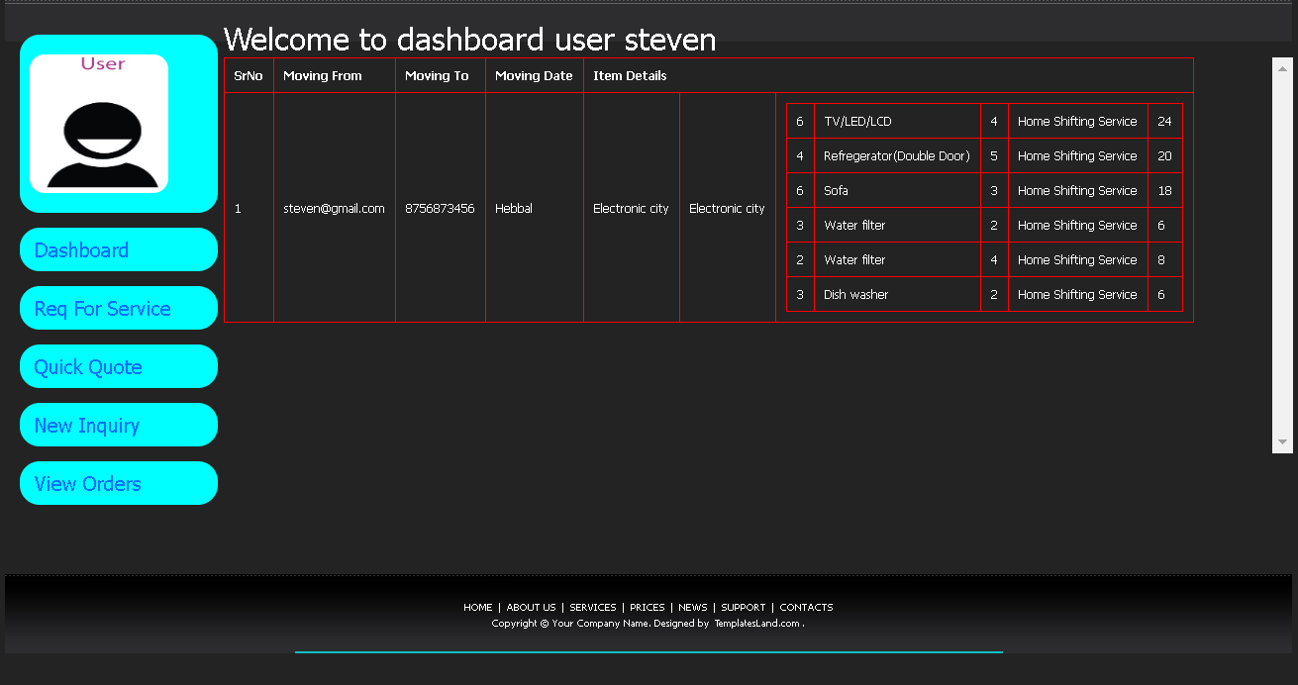
View order details

Slide 54
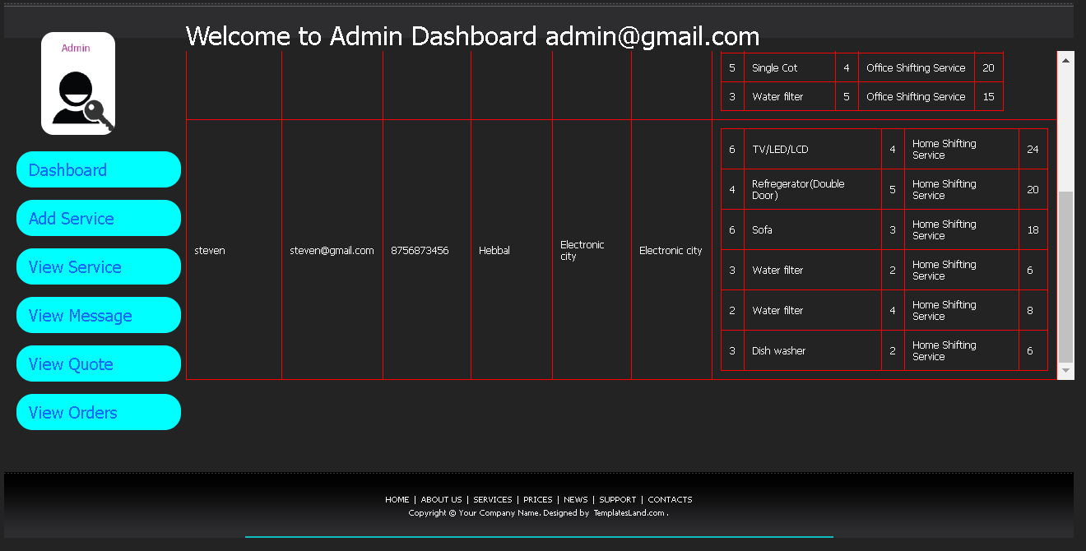
Admin can view order placed by customer

Slide 55
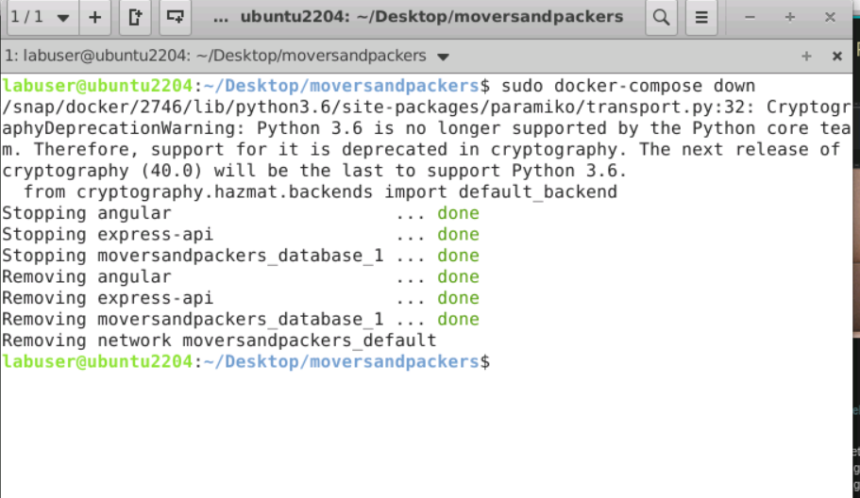
To stop all three containers
sudo docker-compose down

